Slide 1
RUNGTA COLLEGE OF DENTAL SCIENCES AND RESEARCH
Direct filling gold
DEPARTMENT OF CONSERVATIVE DENTISTRY AND ENDODONTICS

Slide 2
Specific learning Objectives
Core areas* | Domain ** | Category #
Classification | Cognitive | Must know
Indications | Cognitive | Must know
Contraindications | Cognitive | Must know
Heat treatment of Gold | Psychomotor | Must know
Cavity Preparation for DFG | Psychomotor | Must know

Slide 3
Contents
Introduction
History
Classification
Characteristics of Gold.
Factors influencing Selection of Gold.
Uses of Gold.
Forms of Direct Filling Gold.
Indications of Direct Filling Gold.
Contraindications of Direct Filling Gold.
Advantages of Direct Filling Gold.
Disadvantages of Direct Filling Gold.
Heat treatment of Gold
Condensation or Compaction.
Biocompatibility of Gold Restorations.
Cavity Preparation for DFG

Slide 4
INDICATIONS OF DFG
1. Incipient carious lesions
Class I lesion in premolar teeth and other accessible developmental pits.
Class V gingival lesions
Class III lesions in maxillary and mandibular anterior teeth.
Class II lesion in premolar teeth when the lesion is small enough to allow a conservative cavity preparation
Class II lesions on mesial proximal surfaces of molars.
2. Erosions
3. Hypoplasias
4. Teeth with no enamel crazing and microcracks.
5. Atypical lesions,
6. Lesions in which enamel margins can be located on sound tooth structure.
7. Lesions in vital teeth.

Slide 5
OTHER USES
For restoring access opening for endodontic therapy.
Faulty margin restoration can readily be accomplished with direct gold instead of amalgam.

Slide 6
CONTRAINDICATIONS
In handicapped, elderly or very young patient unable to sit for longer appointment.
Psychologically unsound patient.
Teeth with large pulp chamber.
Periodontally weakened tooth.
Large carious lesion.
Chalky or melted enamel could contraindicate the use of gold.
Poor patients.
High caries index.

Slide 7
Advantages of DFG
Long lasting restoration.
Do not tarnish or corrode in the oral cavity.
Insoluble and has coefficient of thermal expansion close to that of tooth.
Atraumatic
No tooth discoloration
Direct gold adapts well to the cavity wall and in addition no cementing medium is necessary for retention of restoration.
Easy to polish.
High wear resistance.
Low tendency of molecular change.

Slide 8
Disadvantages
Unesthetic.
Expensive.
Patient discomfort.
Limited to small cavities.
Manipulation is difficult
Technique sensitive.
High condensation force may injure the tooth and supporting tissues.

Slide 9
Heat treatment of Gold:
Degassing or Decontamination.
Purpose of decontamination process –
To drive the impurities off the surface, thus making the surface ready for cohesion.
So keep the surface devoid of any impurities until complete cohesion occurs during building of restoration.

Slide 10
Heat treatment of gold
Gold is kept in closed container when not in use and should not be exposed to contaminate.
All 3 types of gold must receive heat treatment just prior to condensation. This is done to degas the surface of gold and render it cohesive.
Some of the gases may be driven off by heat while other are irreversibly attached.
Reversible gases (oxygen and ammonia) can be readily removed by heat in the range of 900°F to 1300°F.
Care should be taken not to strike matches in the vicinity of the gold lest the sulphur and phosphorous flames contaminated the gold surface.

Slide 11
Degassing can be accomplished in 3 ways:
By an open alcohol frame or piece method of desorption or flame desorption.
Most practical method of annealing
accomplished using simple alcohol flame and gold foil carrier.
Acetone free denatured alcohol must be used to avoid possible contamination from the source.
The wick of the lamp should be pointed and ¼” long.
Gold is picked up with a point of the carrier brought to the hot cone of the flame first long enough to change it to dull red colour.

Slide 12
Middle zone of the flame is used (high energy reducing zone). Each piece of zone is held for 2 to 5 seconds before inserting in the cavity preparation.
For fibrous gold foil this is instantaneous.
Encapsulated powder gold has a flammable indicator. Pellet is held in the flame until indicator burns off and gold appears dull red.
Alloyed filling gold or mat foil are held until the dull red appearance is observed.
All the pieces must be cooled temporarily before carrying to the oral cavity.
Pliers should not be used for piece method since there mass results in uneven diagnosis.

Slide 13
Advantages:
Less wastage
Ability to select gold of desired size and shape.
Elimination of chance of contamination of gold between annealing and use.

Slide 14
2. A mica tray over a flame:
Bulk annealing.
Mica trays are used to hold the gold over the flame.
5 minutes.
Advantage:
Less time than piece method.
Disadvantage:
Sticking of gold pellets.
Unequal heating.

Slide 15
3. Electric degassing or tray desorption:
It is accomplished by an electric annealer.
Electric heater controls the time and the temperature.
The surface of heater is divided into small compartments.
The estimated number of pellets of gold required for the restoration is placed on the surface of the annealer at 650°F.
5 minutes.
Powdered gold pellets take 15-20 seconds whereas gold foil and electrolytic pellet require only 1-2 second.

Slide 16
Advantage :
Convenient method.
No need of assistant.
Disadvantages:
More wastage.
Danger of over annealing.
Sticking of pellets.
Inability to select from annealed gold a piece of desired size that fits the cavity.
Air current affecting heat uniformity.
Over sintering.

Slide 17
COMPACTIONS OF DFG
“Condensation is a procedure used to condense and harden gold inside the cavity preparation”.
Objectives:
Gold is compacted by wedging the initial pieces between dentinal walls.
Weld gold pieces together to ensure complete cohesiveness of their space lattice.
Voids should be avoided from critical areas like the margins and the surface to prevent microleakage.
Bridging

Slide 18
Objectives:
Strain hardening of the gold.
Adapt gold material to the cavity walls and floors.
Elastically deform the dentin of the cavity walls and floors.

Slide 19
TYPES OF CONDENSATION
Hand instrument condensation:
The condensation energy produced by this method is not always sufficient.
Initial increment of material within the cavity

Slide 20
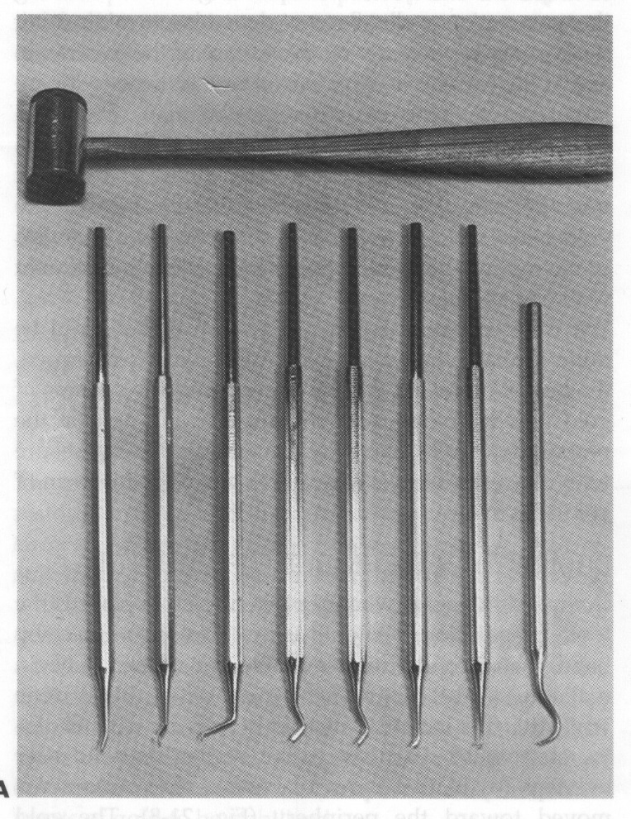
Automatic hand malleting:
Spring loaded instrument that delivers desired force once the spiral spring is released.
Hand condensor and mallet.

Slide 21
Electronic condensation:
McShirley electro mallet.
Accommodates various shapes of condensor points and has a mallet in the handle itself.
Most efficient and controlled way.
The vibrating condenser heads can have an intensity or amplitude from 12 to 15 pounds and frequency of 360 to 3600 cycles / min.

Slide 22
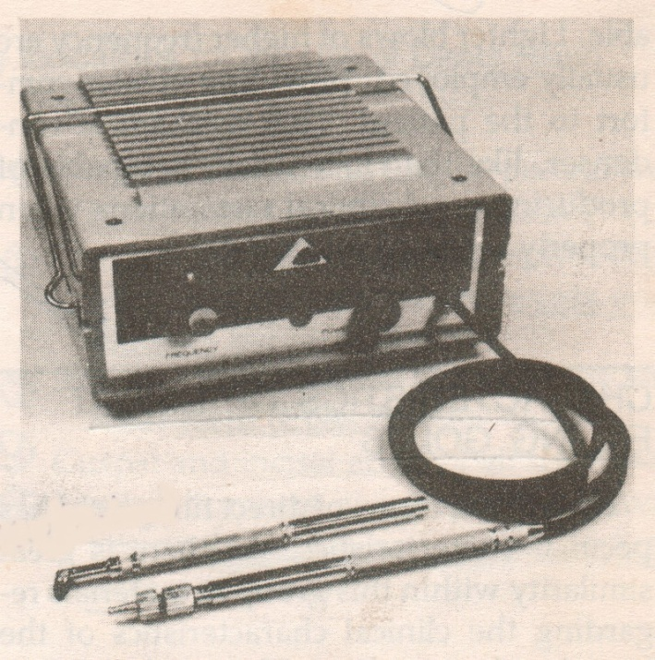
Pneumatic condensation:
Introduced by Dr. George M. Hollenback
Pneumatic mallets consist of vibrating condensor and detachable tips run by compressed air.
Air is carried through thin rubber tubing attached to the handpiece.
Rheostat controls the air pressure and adjusts the frequency and amplitude of condensation stroke.
Pneumatic mallets are available both in straight and angled handpiece.

Slide 23
GOLD CONDENSORS
DFG condensor have faces that are serrated with pyramidal shape configuration. This system has 3 functions:
Increase the surface area of condenser face.
Act as surgger, thus creating lateral forces which will help in fulfilling the objectives of condensation.
Establish some triangular indentation in the condensed piece of gold, so that the succeeding increment of gold may be interlocked and immobilized in these indentations.

Slide 24
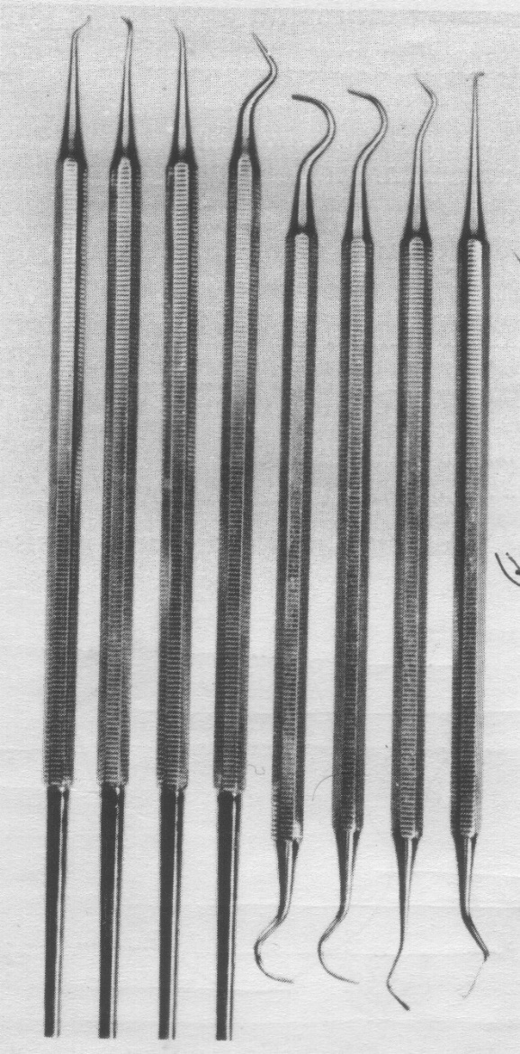
DIFFERENT SHAPES OF DFG CONDENSER
The Blackwood Burg, Ferrier and Loma Linda instrument set are frequently used to condense regular cohesive gold restoration.

Slide 25
Round condensor
Baynet condenser
Used in initial stage of restoration.
Parallelogram and hatchet condenser
Parallelogram condensor is perpendicular while hatchet is parallel to shank
Used for preliminary condensation to create the bulk of the restoration.
Foot condensers
Used mainly for cavosurface condensation surface hardening of restoration as well as bulk build up.
Parallelogram condensor
Hatchet condensor
Foot condensor

Slide 26
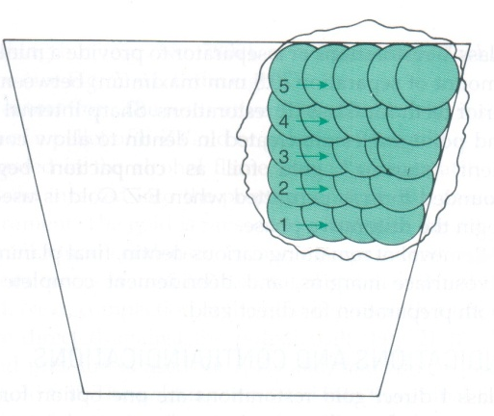
PRINCIPLES OF CONDENSATION
Exert 15lb/sq inch of force on the condenser nib less force is needed for small condenser nibs than for larger ones.
Force of condensation must be 45° to cavity walls and floors
Force of condensation must be directed at 90° to preciously condensed gold.
Stepping procedure for compaction of gold should be carried out.

Slide 27
Use the minimal thickness of pellets possible provided that the condenser will not penetrate it. The thinner the cross-section of each increment the easier is the condensation.
When inserting DFG condensation should either start from one periphery of the increment to the other or from the center to the periphery.
The condensation of precipitated types of direct gold should be started by hand.

Slide 28
PHYSICAL PROPERTIES OF COMPACTED GOLD
Transverse strength is chosen as being most representative of chemical applications.
It is a reflection of 3 types of stress –
Compressive
Tensile
Shear
Any failure can occur from an area of weakness. In DFG’s the failure usually occurs from tensile stress because of incomplete cohesion.
Hardness may not be valid measure of the effectiveness of particular restorative material for its intended purpose of preserving the tooth.
It may however mediate the overall quality of compacted gold. Low hardness probably indicates the presence of porosities.

Slide 29
Conclusion
No metal or combination of metals serve dentistry so well and in a wide range of application as does the gold and its several types. Without gold as a restorative material the practice of dentistry would be changed significantly as no other material serves as its complete satisfactory substitute.
So as a clinician it is our duty to have a good knowledge and idea about its manipulation and cavity preparation.

Slide 30
TAKE HOME MESSAGE
Gold is kept in closed container when not in use and should not be exposed to contaminate.
All 3 types of gold must receive heat treatment just prior to condensation. This is done to degas the surface of gold and render it cohesive.
Some of the gases may be driven off by heat while other are irreversibly attached.
Reversible gases (oxygen and ammonia) can be readily removed by heat in the range of 900°F to 1300°F.
Care should be taken not to strike matches in the vicinity of the gold lest the sulphur and phosphorous flames contaminated the gold surface.

Slide 31
questions
Forms of DFG
Mat gold
Importance and methods of annealing
Steps in compaction of DFG in a cavity
Finishing and polishing of DFG

Slide 32
REFERENCES
Science Of Dental Materials -----9th Edition By Skinners.
Art And Science Of Operative Dentistry -4th Edition-Studervant
Operative Dentistry 2nd Edition By Summit, Robbins ,Schwarts .
Restorative Dentals Materials 11th Edition By Craig.
Packard’s Manual Of Operative Dentistry 8th Edition E.A.M.Kidd, G.N. Smith, T.N.Watson.
Operative Dentistry Edition, By Marzouk .

